Slide 1
BY:- SIDDHARTH DESAI SD-0410
TRANSATLANTIC TUNNEL (FLOATING TUNNEL)
STRUCTURAL DESIGN DEPARTMENT,
CEPT UNIVERSITY,
AHMEDABAD.

Slide 2
CONTENTS
SUBMERGED FLOATING TUNNEL
TRANSATLANTIC TUNNEL
REASON FOR FLOATING
CONSTRUCTION OF TUNNEL
COMPONENTS OF TUNNEL
PROBLEMS TO BE FACED
CONCLUSION
REFERANCES

Slide 3
The Submerged Floating Tunnel
The Submerged floating Tunnel is a tube like structure of Steel or Concrete made to through buoyancy and supported on columns or held in place by tethers attached to the sea floor or by pontoons floating on the surface.
The Submerged floating tunnel utilizes lakes and waterways to carry traffic under water and on to the other side, where it can be conveniently linked to the rural network or to the underground infrastructure of modern cities.

Slide 4
In recent times, the needs of society for regional growth and the protection of the environment have assumed increased importance. In this wider context the submerged floating tunnel offers new opportunities.
The submerged floating tunnel is an innovative concept for crossing waterways, utilizing the law of buoyancy to support the structure at a moderate and convenient depth.

Slide 5
The beauty of the bridge is that it takes over to the other side. The beauty of the bridge is also the aesthetic impression.
Sometimes it might be best if the bridge was not there, because of the environmental impact a bridge may have, such as noise, pollution and disruption to the scenery. But then you cannot get across – to the other side.

Slide 6
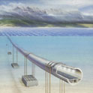
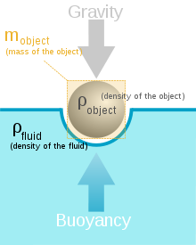
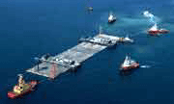

Slide 7
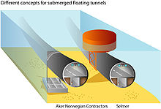
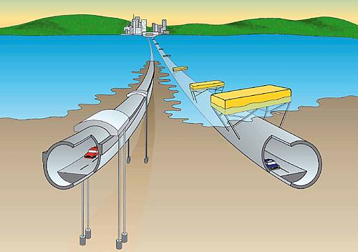
Suspended from the Pontoons
Attached to the sea floor

Slide 8
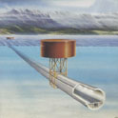
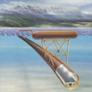
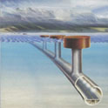

Slide 9
TRANSATLANTIC TUNNEL
A Transatlantic tunnel is a theoretical tunnel which would span the Atlantic Ocean between North America and Europe and would carry some sort of mass transit—trains are envisioned in most proposals. Using advanced technologies, speeds of 300 to 5,000 mph (500 to 800 km/h) are envisioned.

Slide 10
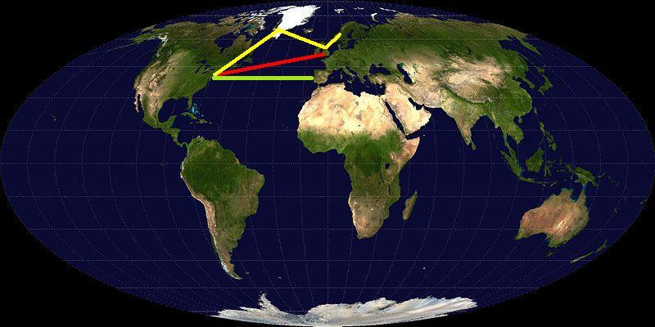
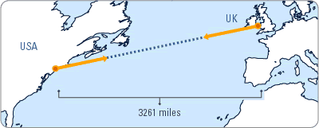
Yellow - New York - Greenland, Great Britain & Norway
Red - direct to London.

Slide 11
Plans for such a tunnel have not progressed beyond the conceptual stage, and no one is actively pursuing such a project.
The main barriers to constructing such a tunnel are cost—as much as $12 trillion and the limits of current materials science.
A Transatlantic Tunnel is 215 times longer than the longest current tunnel and would cost perhaps 3000 times as much.

Slide 12
REASON FOR FLOATING
Floating tunnel is the totally new concept and never before use even for very small length.
It can be observed that depth from place to place on a great extent. The max depth is up to 8 km. also at certain sections. (avg. Depth 3.3 km)
The two more alternatives are available for constructions are bridge above water level or tunnel below ground level.

Slide 13
But as we seen,
the depth is up to 8 km it is impossible to construct concrete columns of such height.
Secondly,
If we go for 2nd option,
the pressure below 8km from sea surface is nearly about 500 times than atmospheric pressure so one can not survive in such a high pressure zone.

Slide 14
Therefore, floating tunnel is finalised which is at a depth 30m from sea level At which there is no problem of high pressure. This is sufficient to go any big ship to pass over it without any obstruction.

Slide 15
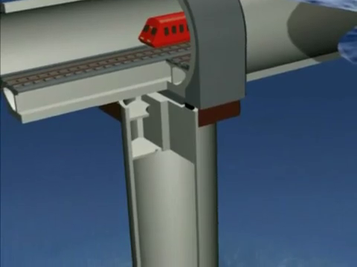

Slide 16
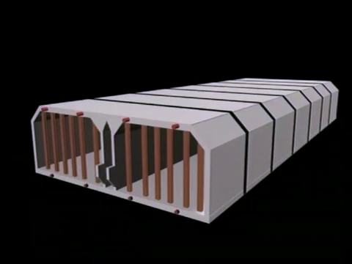
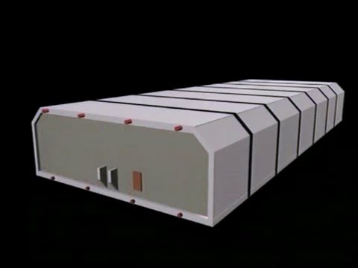

Slide 17
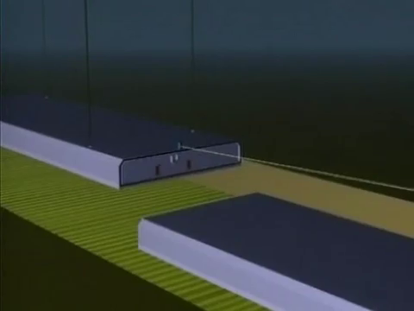
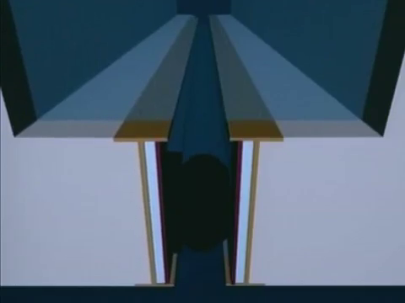
RUBBER CAP SEAL

Slide 18
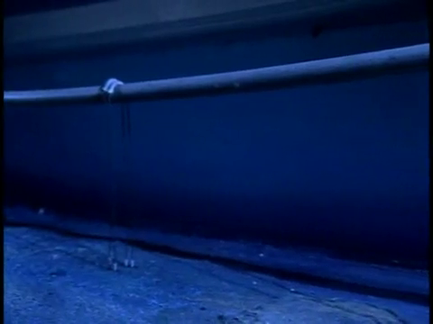
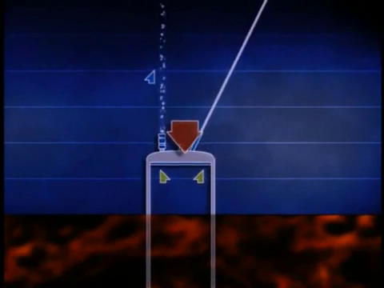

Slide 19
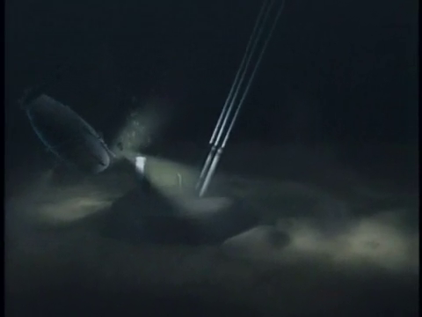
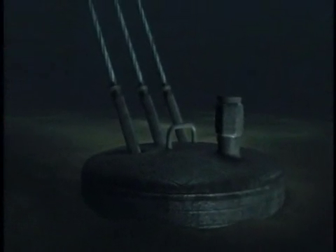

Slide 20
COMPONENTS OF TUNNEL
Following are the main components of this Tunnel
Gasket/shell
Sea anchors
Utility conduits and service port
Vacuum pumps
Maglev train
Guide ways

Slide 21
GASKET/SHELL
As the tunnel is situated at a depth of 30m, it should be perfectly water tight and secondly it should resist the salty sea water and thirdly it should be withstand against hydrostatic forces coming on it.
Therefore it is made of 4 layers. Outermost layer is constructed of aluminium to resist the salty sea water. Second and third layer is made of the foam to float the tunnel easily in water. Fourth layer is of concrete which gives strength to the tunnel.

Slide 22
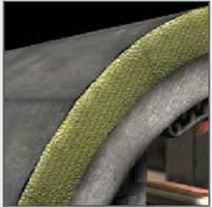
As the length of tunnel is very large, it is not possible to construct the tunnel at situ. Therefore it is made up of 54000 precast units. These units are casted on shore and transported to place where they have to fix the units with two large floating platforms.

Slide 23
SEA ANCHORS
As the tunnel is in the Atlantic Ocean, it should have to face high current velocity in Atlantic Ocean.
The tunnel should not deflect much with water current. Therefore it anchored to the sea bed with the help of steel anchors.

Slide 24
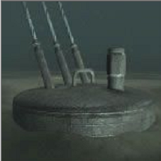
The procedure is as follows
First, ropes are attached to a block and this block is inserted in sea bed water come out from top and forms a hydrostatics seal which holds the block firmly in sea bed.

Slide 25
VACUUM PUMP
The train is running with such a thrilling speed of 5000 mph in the tunnel. The air resistance is too high on such a high speed. Therefore to reduce it and increase the speed of train, vacuum is created in tunnel.
But creating vacuum in such a long tunnel is very difficult task. With available equipments, 100 propellers of most powerful boing jet are require to evacuate the air continuously for 15 days. The vacuum pumps are installed throughout the length of tunnel to maintain the vacuum in it.

Slide 26
SERVICE PORT
The tunnel is powered by electrically which should be available for entire length of tunnel. These electrical wires are carried out through utility conduits.
The two service ports are provided in tunnel, one above and other below the track conduit. These are provided for communication and access for repair works.

Slide 27
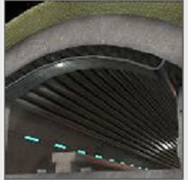

Slide 28
MAGLEV TRAIN
These are magnetically elevated trains. These trains do not run over the track but floats slightly above the track.
Thus we can achieve practically zero tractive resistance between train and track.
Further this train will pass though vacuum, which increase the speed of train.
The sensation of flying at 400mph with no engine noise or vibration will make the journey through the tunnel a unique experience.
Special rotating and pivoting seats are provided to further reduce the effect of gravitational force.

Slide 29
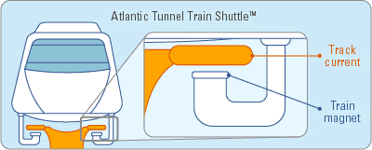

Slide 30
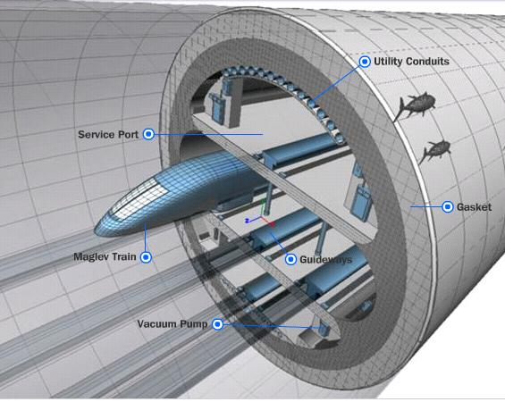

Slide 31
CHALLENGES TO BE FACED
Cost: - Due to lots of material and machinery involved in project, estimated cost is nearly 1.2 Thousand crore dollars.
Fire: - It is difficult to rescue people if fire will break out in train and also to face the problems due to the smoke of fire.

Slide 32
Collision: - If in case of collision of two trains took place , it is very difficult to rescue the people.
No Stoppage: - It is very difficult to stop the train travelling on such a high speed.

Slide 33
“TITANIC AGAIN?”
“SHIP HITS THE TRANS-ATLANTIC TUNNEL ENDED UP IN GREAT TRADEGY”

Slide 34
CONCLUSION
The tunnel will set new trends in transportation engineering and which shows with the advances in technology we can reduce the time required for travelling and make the transportation more effective.
By hiding the traffic under water, the beauty of landscape is maintained and valuable land is available for other purposes. Benefits can be obtained with respect to energy consumption, air pollution and reduced noise emission.

Slide 35
For wide and deep crossings the submerged floating tunnel may be the only feasible fix link , replacing present days ferries and providing local communities with new opportunities for improved communication and regional development.

Slide 36
REFERANCES
http://dsc.discovery.com/convergence/engineering/transatlantictunnel/interactive/interactive.html
www.wikipedia.org
www.google.com
www.youtube.com

